Slide 1
Principal component analysis (PCA)

Slide 2
Useful resources
Karl Pearson F.R.S. (1901) LIII. On lines and planes of closest fit to systems of points in space, The London, Edinburgh, and Dublin Philosophical Magazine and Journal of Science, 2:11, 559-572, DOI: 10.1080/14786440109462720
Hotelling, H. (1933). Analysis of a complex of statistical variables into principal components. Journal of Educational Psychology, 24(6), 417–441. https://doi.org/10.1037/h0071325
Jolliffe, Ian T. and Cadima, Jorge (2016) Principal component analysis: a review and recent developments Phil. Trans. R. Soc. A.374 https://doi.org/10.1098/rsta.2015.0202

Slide 3
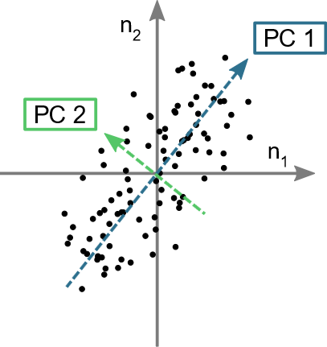
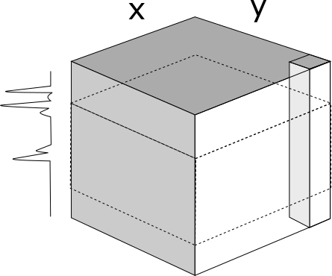

Principal component analysis
Aim: reduce a dataset with many variables by fewer variables that represent the majority of the key features
Seek correlation between measured variables
Aid visualisation and identify trends
p₂
Raman map
(n x p) array
p wavenumbers
p₁ | … | p_{j} | … | p_{J}
p₁
n spectra (n = xy)
p wavenumbers
PCA results do not account for position or surrounding spectra

Slide 4
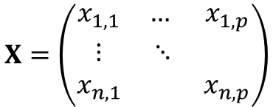

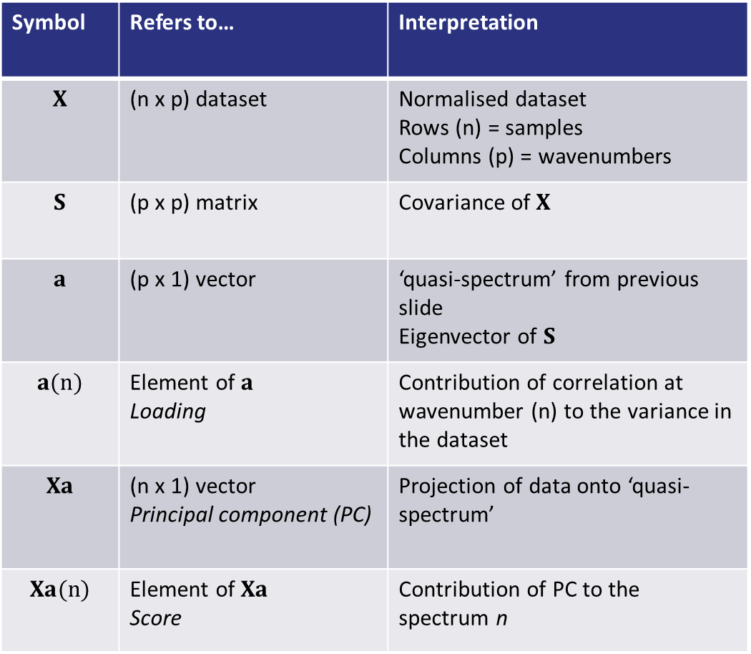
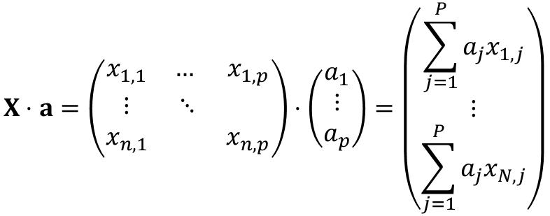

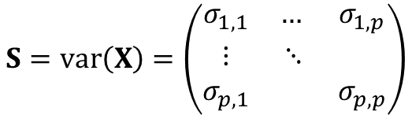
Principal component analysis: terminology reference
Symbol | Refers to… | Interpretation
$$X$$ | (n x p) dataset | Normalised dataset Rows (n) = samples Columns (p) = wavenumbers
$$S$$ | (p x p) matrix | Covariance of $X$
$$a$$ | (p x 1) vector | ‘quasi-spectrum’ from previous slide Eigenvector of $S$
$$a(n)$$ | Element of $a$ Loading | Contribution of correlation at wavenumber (n) to the variance in the dataset
$$Xa$$ | (n x 1) vector Principal component (PC) | Projection of data onto ‘quasi-spectrum’
$$Xa(n)$$ | Element of $Xa$ Score | Contribution of PC to the spectrum n
$$X=\left(\begin{matrix}x_{1, 1} & … & x_{1, p} \\ ⋮ & ⋱ & \\ x_{n, 1} & & x_{n, p}\end{matrix}\right)$$
$$S=var\left(X\right)=\left(\begin{matrix}σ_{1, 1} & … & σ_{1, p} \\ ⋮ & ⋱ & \\ σ_{p, 1} & & σ_{p, p}\end{matrix}\right)$$
$$Sa=λa$$
Principal component because ordered by eigenvalue, $λ$
$$X⋅a=\left(\begin{matrix}x_{1, 1} & … & x_{1, p} \\ ⋮ & ⋱ & \\ x_{n, 1} & & x_{n, p}\end{matrix}\right)⋅\left(\begin{matrix}a_{1} \\ ⋮ \\ a_{p}\end{matrix}\right)=\left(\begin{matrix}\sum_{j=1}^{P}{a_{j}x_{1, j}} \\ ⋮ \\ \sum_{j=1}^{P}{a_{j}x_{N, j}}\end{matrix}\right)$$

Slide 5
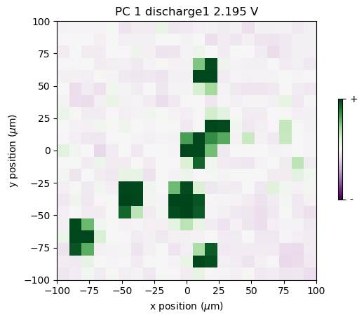
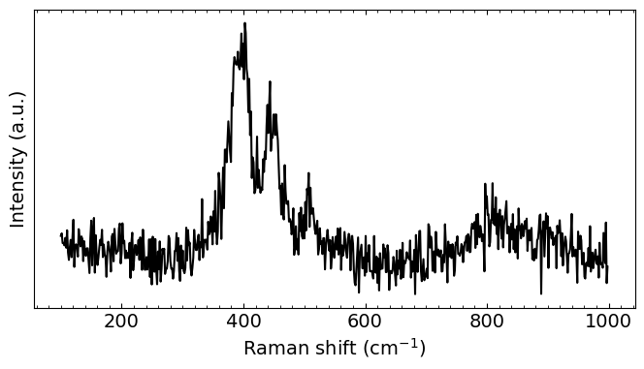
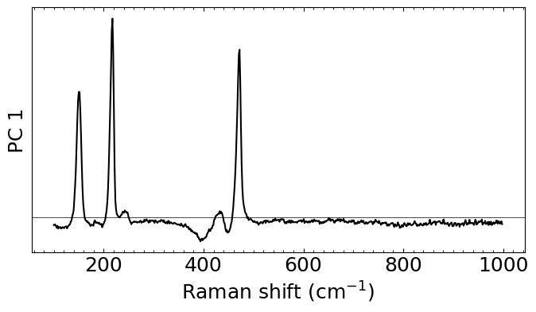
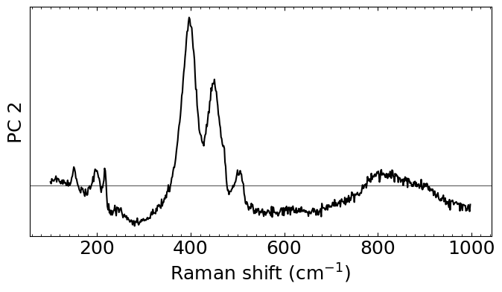
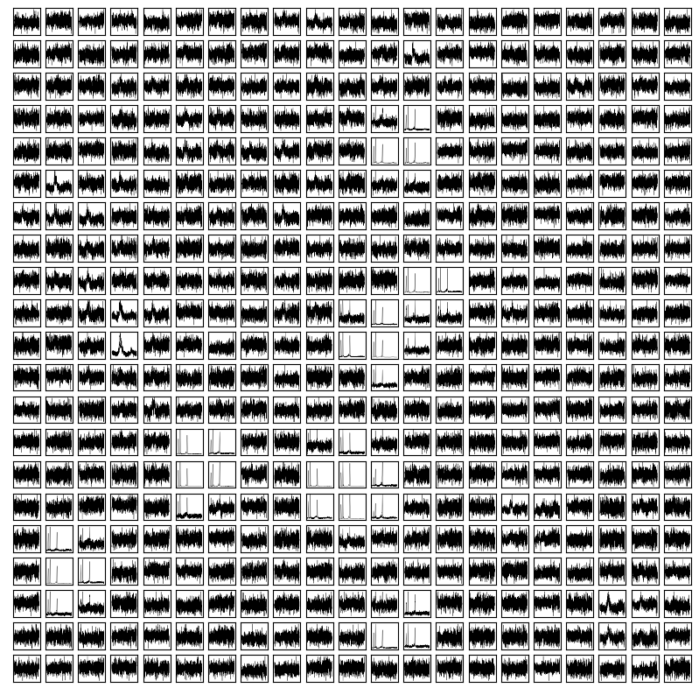
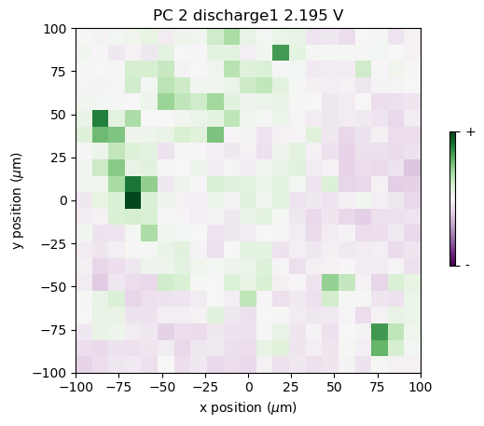
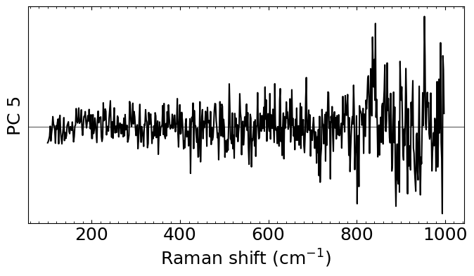




Principal component analysis
$${Xa}_{1}\left(x, y\right)×$$
$${Xa}_{2}\left(x, y\right)×$$
$$…$$
$$Xa_{N}\left(x, y\right)×$$

Slide 6
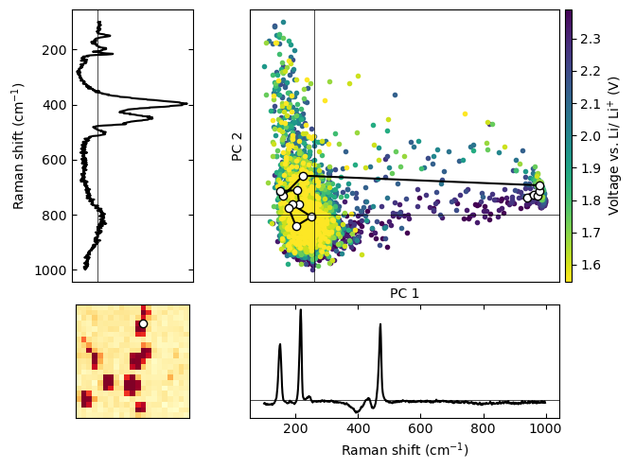
PCA: Rapid Visualisation
Notes:
Brief aside about further application of PCA when monitoring operando spectra:
All spectra are collected within same map region, with extraneous variables kept as constant as possible (e.g. roughness, Raman laser intensity and heating, presence/ absence of overlying excess electrolyte)
Assume that the majority of variance is due to changes in species present
Apply PCA: each point in the scatter graph corresponds to a single spectrum, with colours corresponding to map voltage
The trace of points highlighted in black corresponds to a voltage series at the position shown in the map (bottom left)
The X and Y axis correspond to the adjacent PCA vectors (X = sulfur intensity, Y=polysulfides)
Spectra collected from this specific location show a rapid jump from sulfur-dominated to low sulfur/ low PS intensity, as opposed to possible gradual progression through different species at this location, indicative of sulfur utilisation and diffusion of active materials away from this location, and as opposed to gradual diminution of sulfur peaks
This method (i.e. PCA fit and transform) can be applied instantly to operando data provided assumption of constant background is met)

Slide 7
K-nearest neighbours

Slide 8
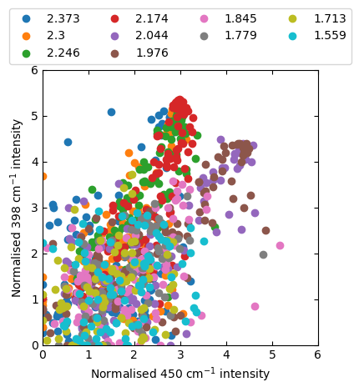
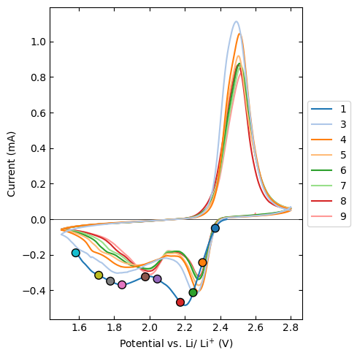
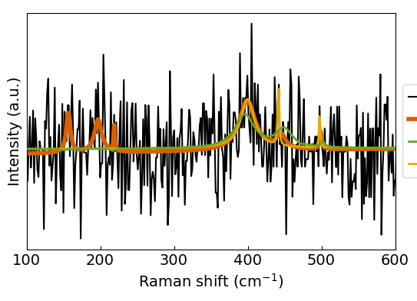
Operando Raman Data: Challenges
High signal to noise ratio
Low signal to noise ratio
Notes:
Scatter plot shows fitted intensities of highlighted peaks from previous slide, with long-chain PS on y-axis and ambiguous peak on x axis. Marker colours correspond to cell voltages on CV plot on the left.
Potentially some correlation, with an abrupt change in the relationship between the peaks following the first reduction peak
However, noisy spectra mean low intensities, spurious fits to noise, and other factors cloud identification of relationship, and biases the distribution of peak intensities towards zero (since many low intensity false-positives are included).

Slide 9
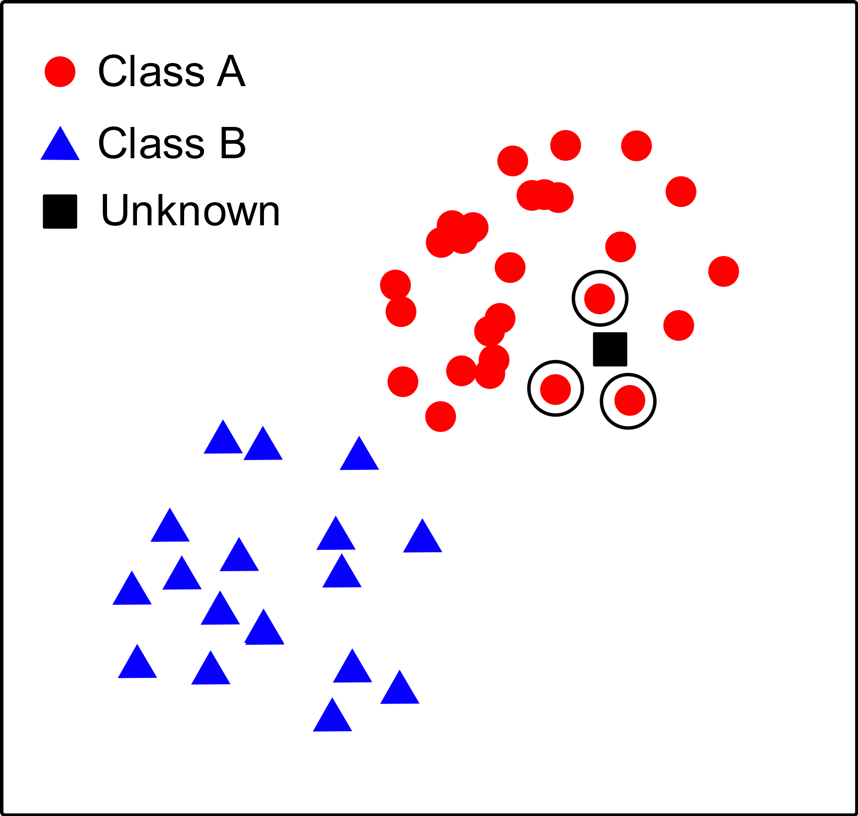
Operando Raman Data: Challenges
Low signal-to-noise ratio:
Rapid data acquisition
Sample roughness
Spurious peak fits
Principal component analysis (PCA):
Summarise large dataset
‘Clusters’ of similar spectra
K-nearest neighbours classifier:
Train classifier on subset of data
Distinguish noise- and signal-dominated spectra
Principal component 2
Principal component 1
Notes:
Low signal to noise ratio is likely to be unavoidable for operando data as it requires a rapid acquisition time, sample roughness leads to change in focal plane that is difficult to adjust experimentally
However, filtering out spurious fits is difficult: thousands – tens of thousands of spectra collected for a single voltage scan
PCA summarises large datasets (requires all data collected in identical background conditions) – results in clustering of similar spectra (similar latent variables)
Enables application of K-nearest neighbours classifier – based on training labels, the classifier compares the unlabelled data to those that are labelled and classifies it according to parameter proximity.

Slide 10
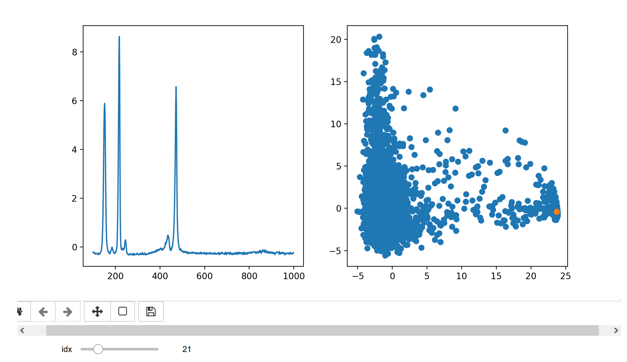
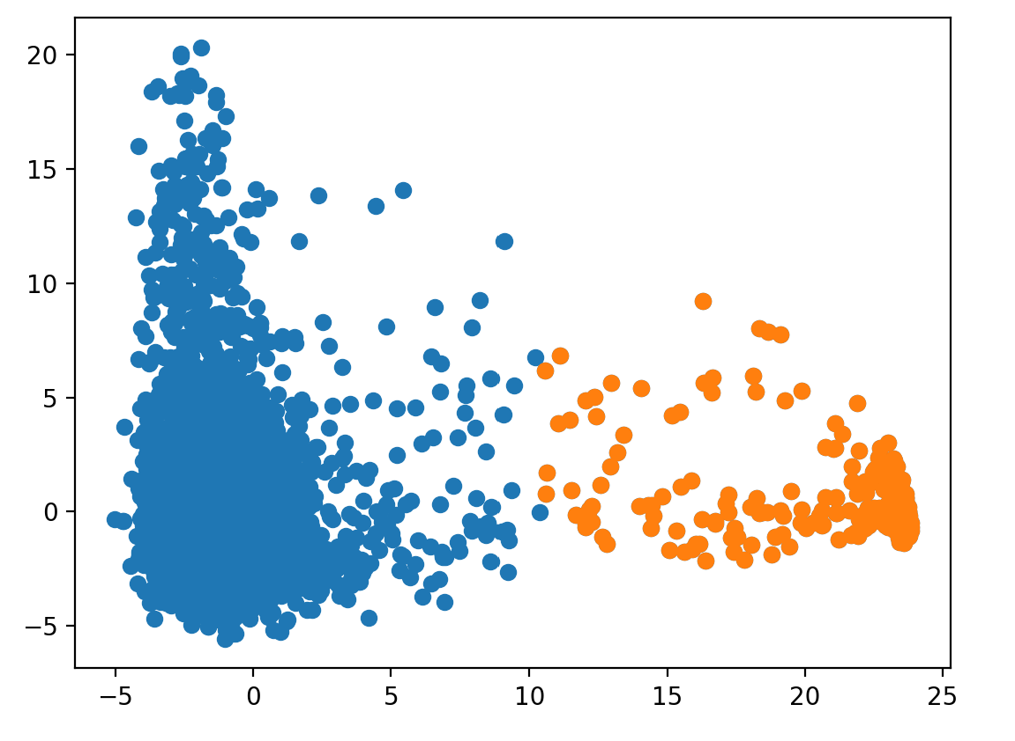
Classification: Example
Raw S₈ spectrum
Implemented in iPython notebook
Training data:
Manual labelling of PCA scores
Subset of data (e.g. 10%)
Randomised
Duration: ~ minutes
Apply classifier:
All spectra in CV scan
Duration: < 1 second
Identified S₈
spectra
Principal component 2
Principal component 1
Notes:
All of the spectra from a given CV scan have dimensions reduced using PCA. A random subset of spectra is presented to the user:
Random to prevent e.g. seeking sulfur because sulfur forming at the end of charging indicates good cell performance
Ensures representative labelling of spectra with no features
Example: label ~100 spectra out of ~6000 for CV scan (takes ~ 5 minutes)
Application of trained classifier: very rapid, classifies by spectrum index
Applied in ‘PCA’ space, but related to ‘real’ space using indices.

Slide 11
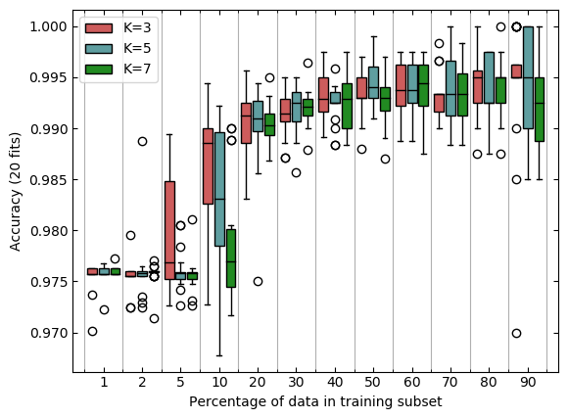
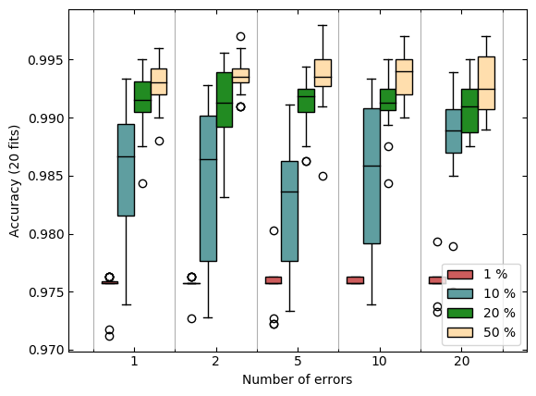
Label optimisation and error resilience
Test/ train size accuracy
Introducing erroneous labels

Slide 12
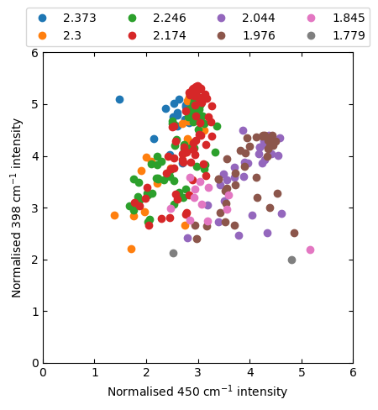
Classification: Results
All data points displayed
KNN classifier applied
Notes:
Quick demonstration of results: removal of low intensity spurious fits shows ‘true’ range of intensity values for signal-dominated peaks (eliminating artificially low intensities from fitting artefacts).

